Slide 1

Data Science and Analytics
House Price Prediction
05/12/2019
GROUP C Jane(Yu-Chen) Su, Leon Tan, Yuxiang Zhao,
Kushagra Patel, Anisha Vimalan, Yangyang Yan

Slide 2
AGENDA
Framing the Problem
Problem Recognition
Review of Previous Finding
Solving the Problem
Modeling and Variable Selection
Data Collection
Data Analysis
Quantitative Analysis and Creativity
Communicating on Results
Result Presentation and Action
Limitation

Slide 3

1. Framing the Problem
Problem Recognition
Review of Previous Finding

Slide 4
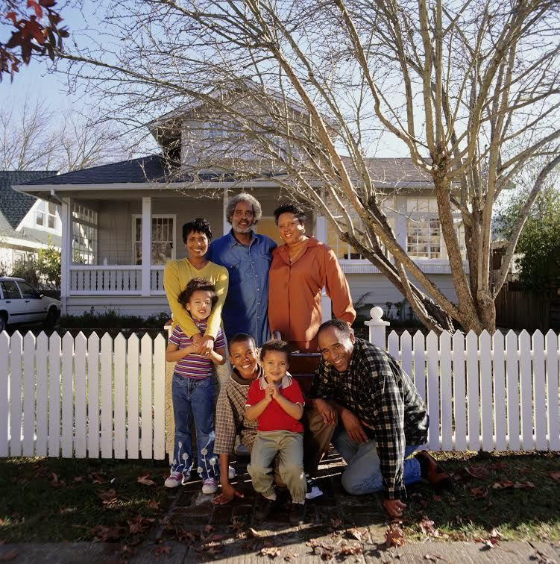
Problem Recognition
American Dream
“that dream of a land in which life should be better and richer and fuller for everyone, with opportunity for each according to ability or achievement”
-James Truslow Adams

Slide 5
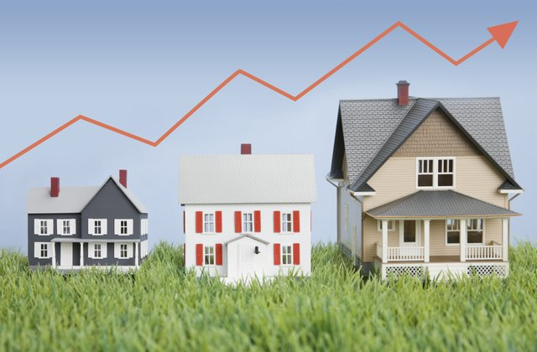

Review of Previous Findings
When was it built?
How big is the room?
How many square feet of living space is in this house?
Is there a basement?
How many bathrooms are there?

Slide 6
2. Solving the Problem
Modeling and Variable Selection
Data Collection
Data Analysis
Quantitative Analysis and Creativity

Slide 7
Modeling and Variable Selection
After extensive research, we selected three variables and assumed that people will consider them while purchasing houses.
Variable | Explanation
Overall Quality | Ratings of the overall material and finish of the house
First Floor Square Feet | The area of the first floor in square feet
Number of Bedroom | The number of bedrooms above the ground Basement bedrooms are not included

Slide 8
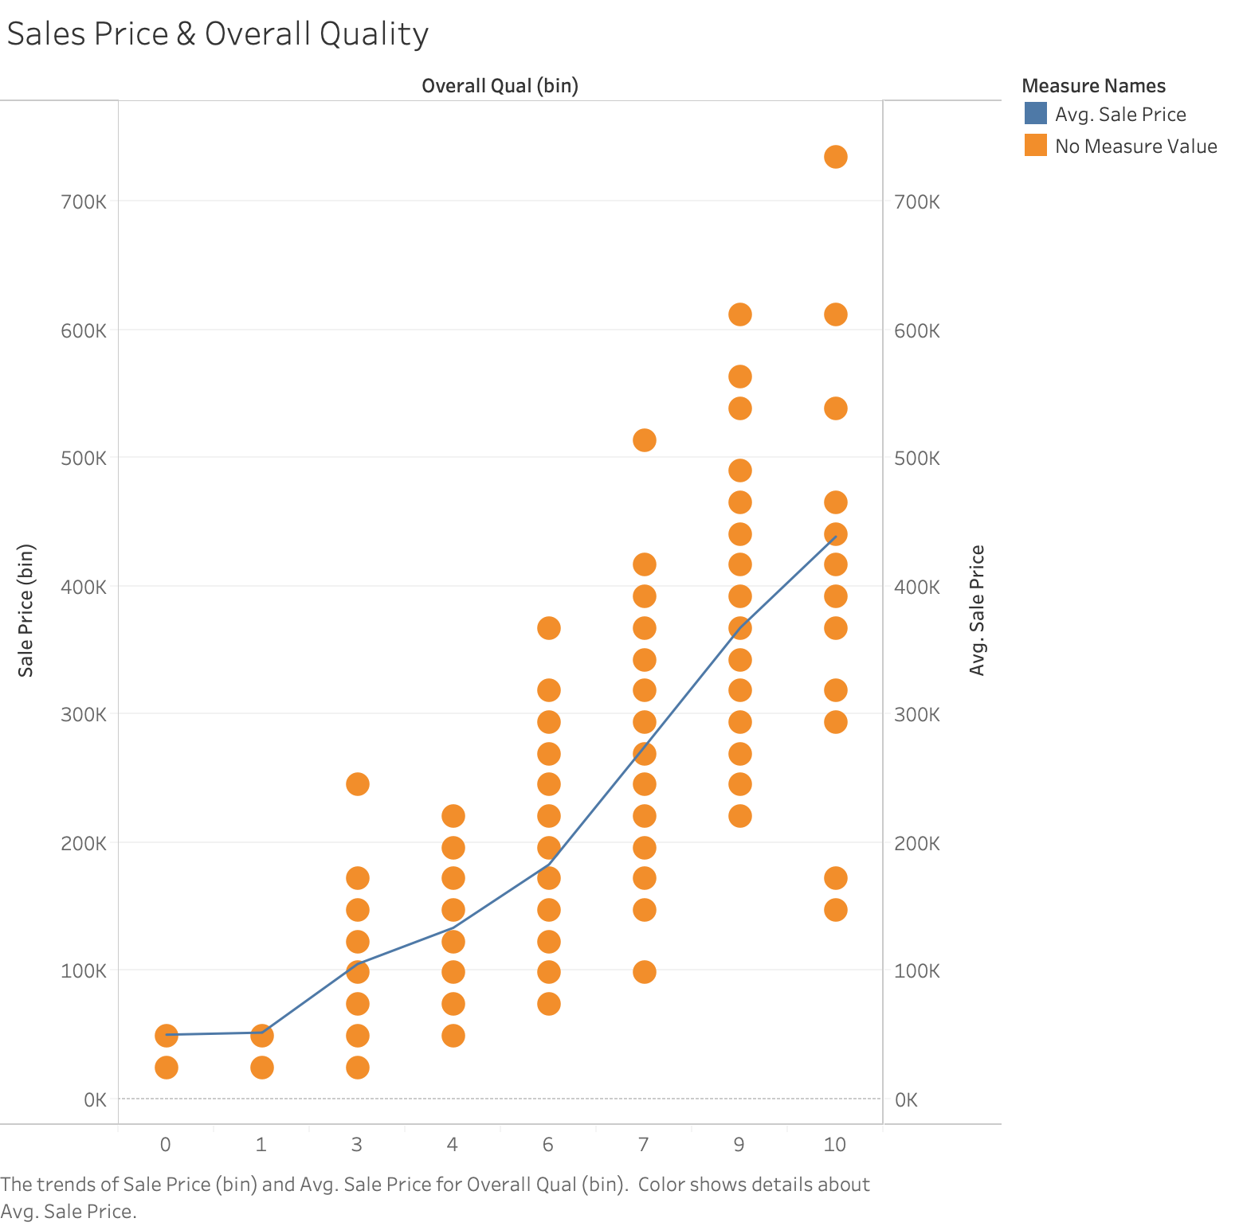
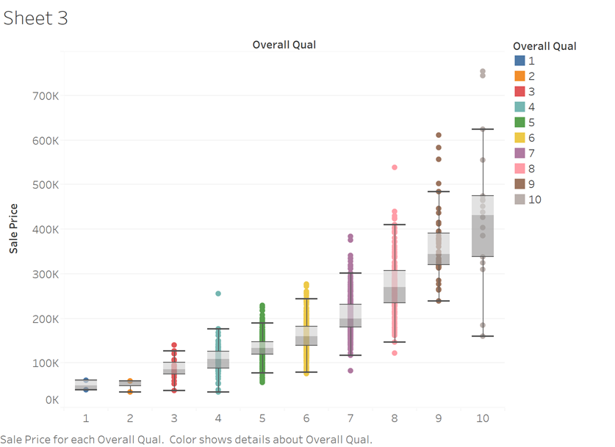
Overall Quality
House prices depend on which material is used by the developer during the construction of the house along with the interior finish.
Scatter plot of Overall Quality by Sale Price
Box plot of Overall Quality by Sale Price

Slide 9
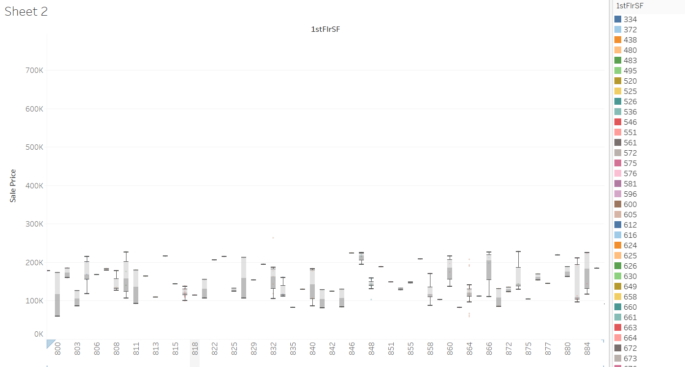
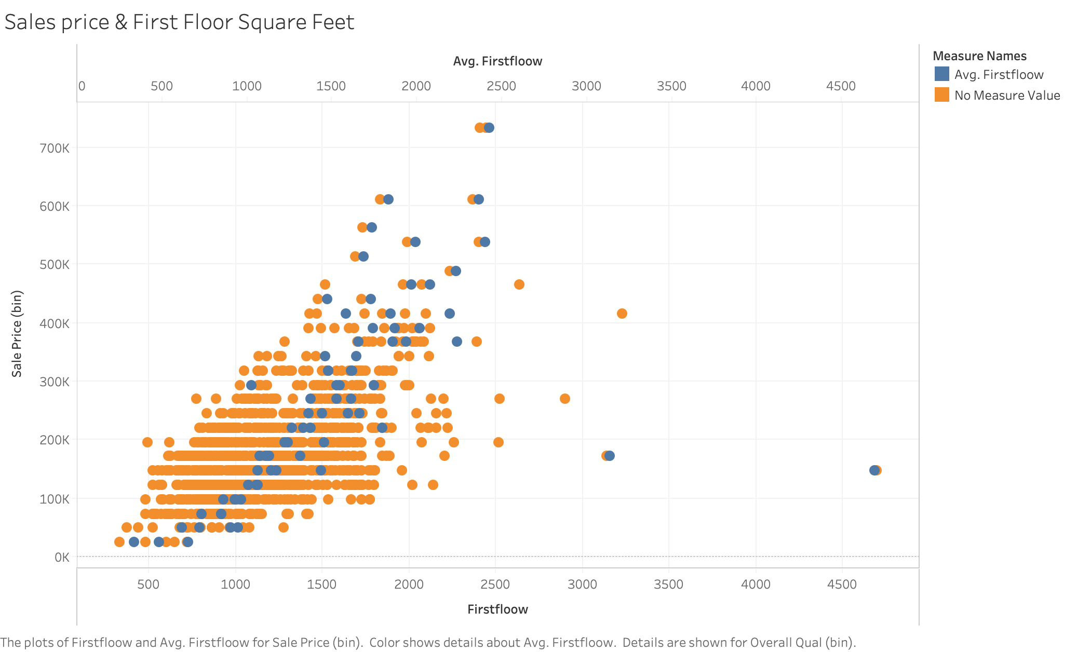
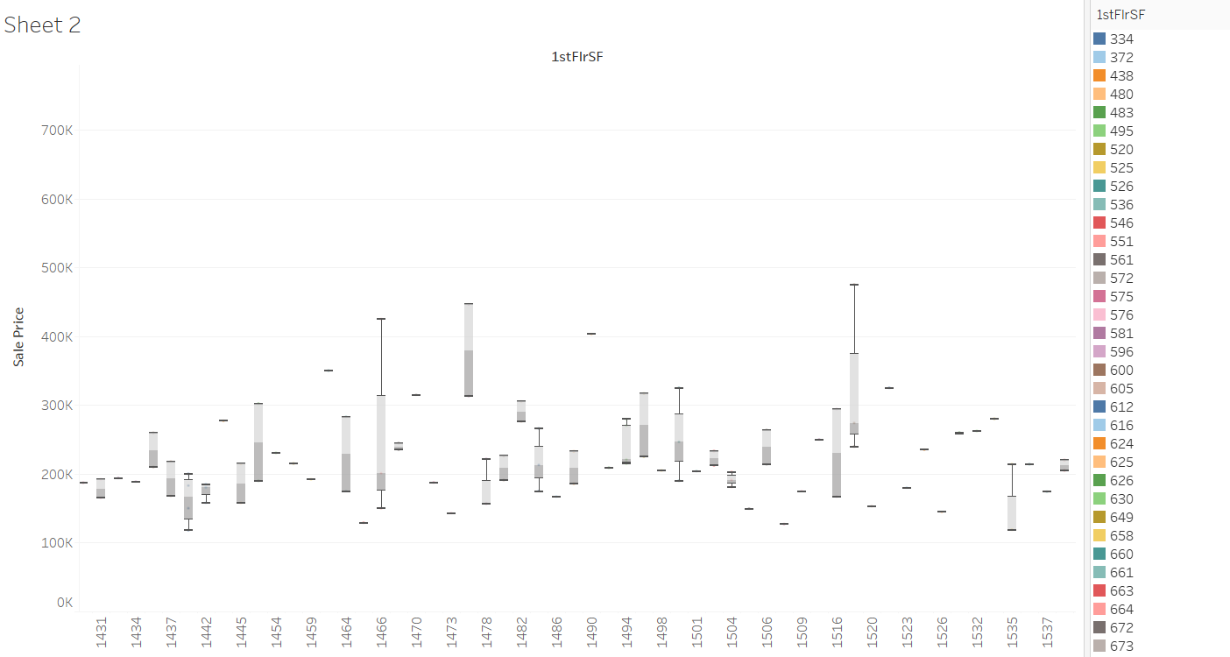
1st Floor Square Feet
Box plot of First Floor Square Feet feet by Sale Price
People spent the majority of their time on the first floor as compared to the other floors in the house.
Scatter plot of First Floor Square Feet y by Sale Price

Slide 10
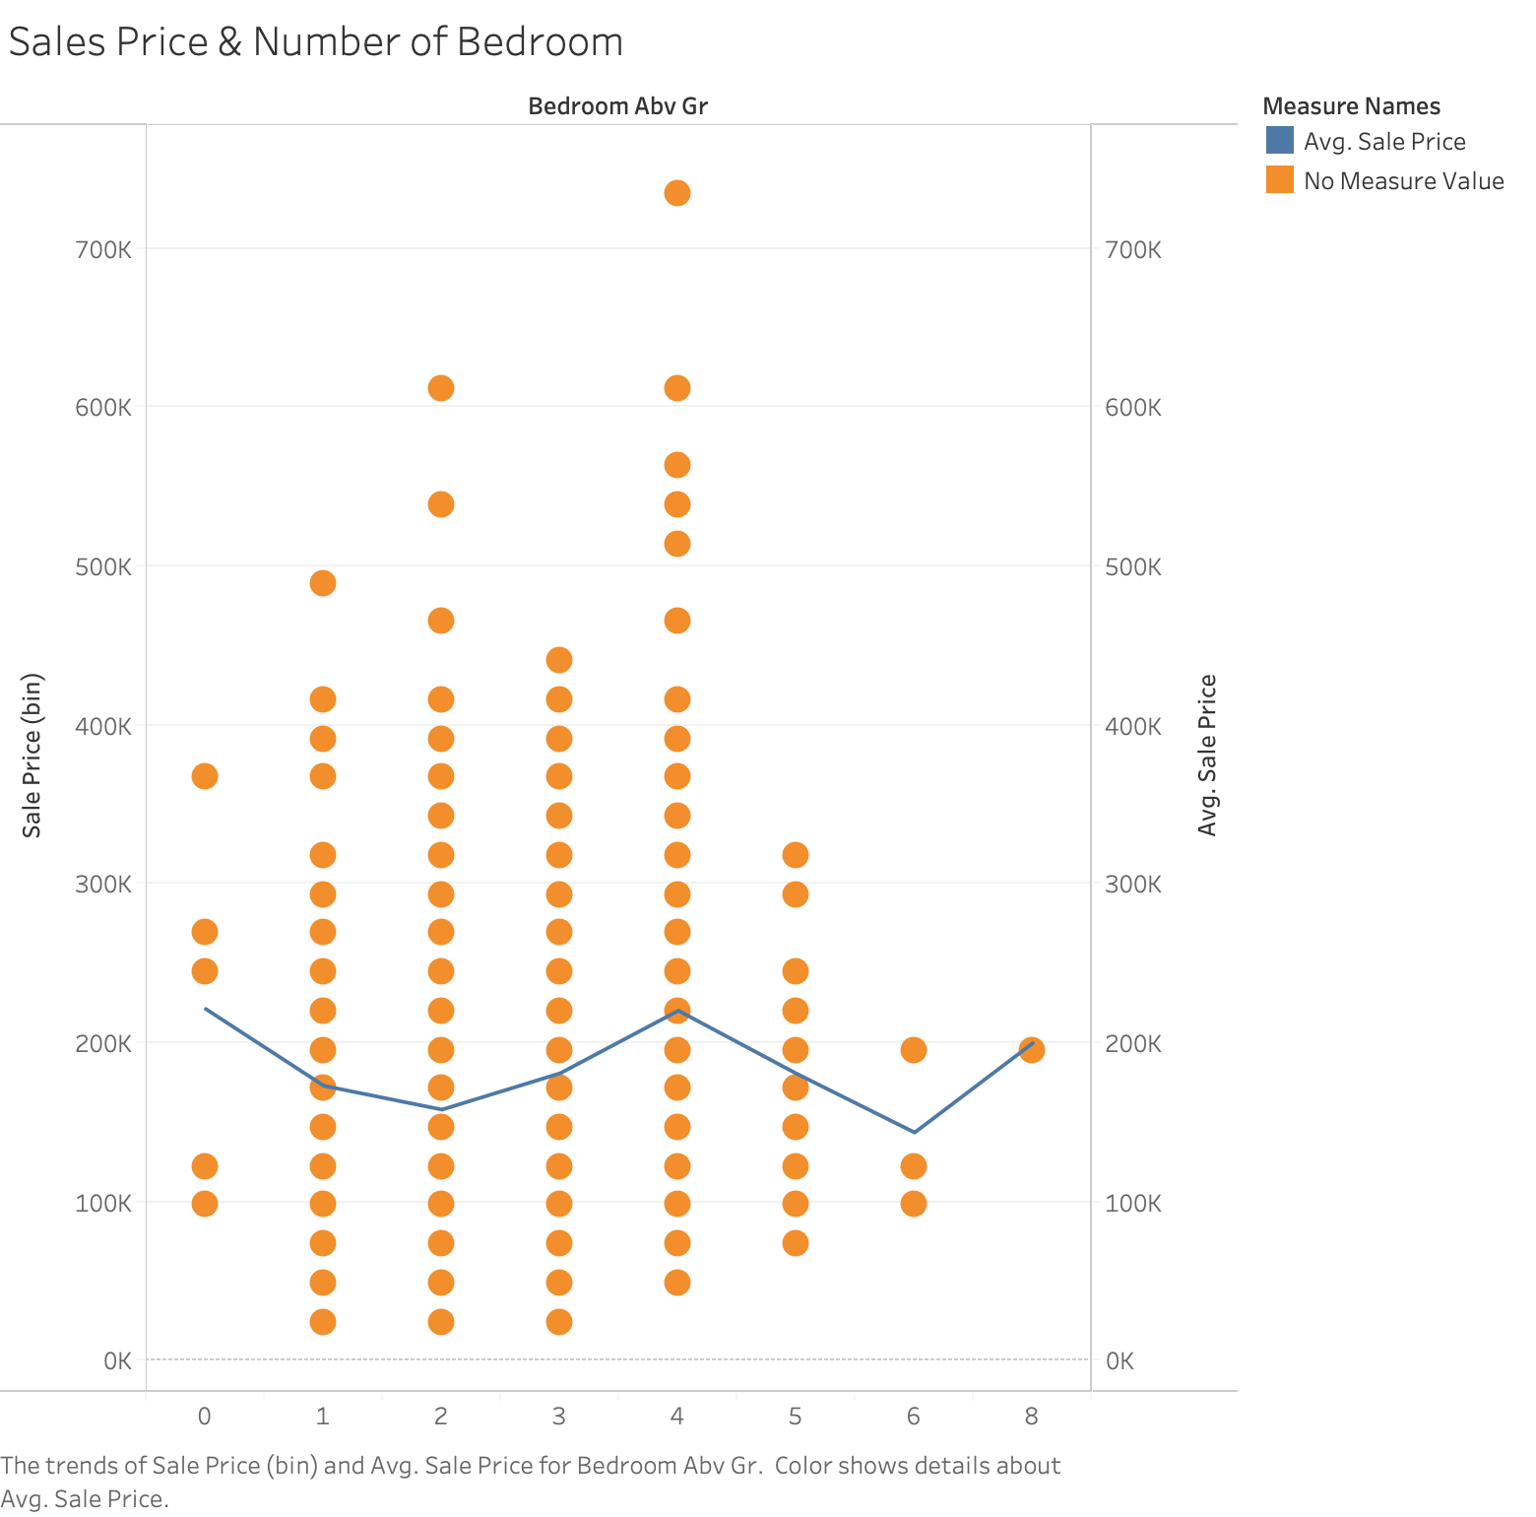
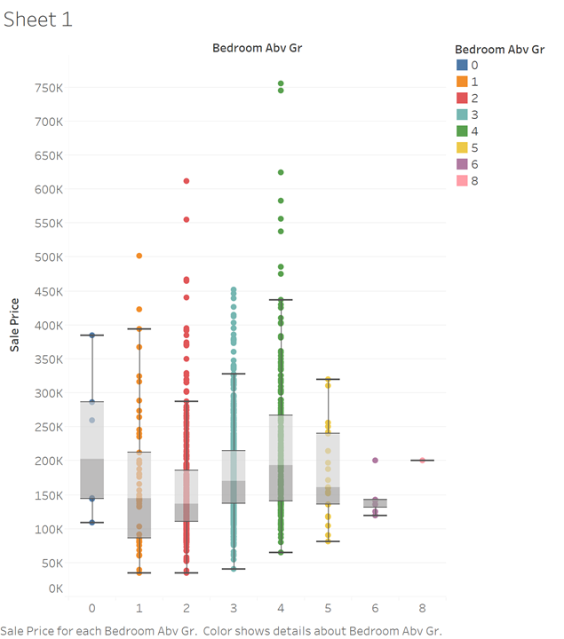
Number of Bedroom
More bedrooms imply bigger lot area, more occupants, more house levels, etc.
Scatter plot of Number of Bedroom by Sale Price
Box plot of Number of Bedroom by Sale Price

Slide 11
Data Collection
Kaggle Open Datasets
This Ames Housing database was compiled by Dean De Cock, the professor of statistics at Truman State University
In addition, the professor studied about Boston’s housing data during his graduate studies
In fact, the initial original database collected by the Ames City Assessor's Office was used for tax assessment purposes.
The original dataset contains 113 variables which were a combination of nominal, ordinal, continuous, and discrete data and describe 3,970 property sales.

Slide 12
Data Analysis
Descriptive Statistics
Linear Regression
Assumption tests
To summarize the data in a meaningful way
Identify some patterns in the data
House price increases with increase in first-floor area, number of bedrooms and the overall quality
Examine the relationship between two or more variables of interest
Ideal method to mathematically sort out which independent variables have a significant impact on the dependent variable
Shapiro-Wilk normality test
Non-constant variance score test for homogeneity of variances
Durbin Watson test for independence
Multicollinearity test

Slide 13
Quantitative Analysis
The standard deviation of house price is $ 79,442.5 which is very high and indicates more heterogeneous or dissimilar spread of the data
From linear regression model, we got
SalePrice = -133,055 + 37,128 * OverallQuality + 59.53 * FirstFloor + 6,387 * Bedroom
p-value is 2.2e-16 which is less than significance level, therefore the model is statistically significant
R-squared for the model is 0.6978

Slide 14
Quantitative Analysis
In Shapiro-Wilk test, we observed p-value < 0.05, hence the residual is not a normal distribution
In Independence test, we observed p-value = 0.918 which is greater than 0.05, hence residuals are independent of each other
In NCV test, we observed p-value < 0.05, hence residual variance has no homogeneity

Slide 15
Quantitative Analysis
The correlation coefficient between Sales price and Number of Bedrooms was observed to be 0.169, between Sales price and First Floor area was 0.605, and between Sales price and Overall Quality was 0.79
There is no multicollinearity problem as all VIF are smaller than 10.

Slide 16


Creativity
Creative by selecting overall quality and first floor area as independent variables
Creative by first using descriptive statistics to form our hypotheses and then developing a linear regression model to test our hypotheses.
Use of correlation to check independent variables similarity

Slide 17
3.Communicating on Results
Result Presentation and Application
Limitation

Slide 18
Explanation
SalePrice = -133,055 + 37,128 * OverallQuality + 59.53 * FirstFloor + 6,387 * Bedroom
On average, each level of overall quality increase leads to $37,128 increase in predicted sales price
On average, predicted sales price increases $59.53 with one square feet more in first floor area
On average, one more bedroom raises $6,387 in predicted sales price

Slide 19
Explanation
SalePrice = -133,055 + 37,128 * OverallQuality + 59.53 * FirstFloor + 6,387 * Bedroom
Sales price is significantly influenced by three independent variables: overall quality, first floor square feet and number of bedrooms.
Three independent variables explained 69.78% change of dependent variable (sales price)

Slide 20
Application
A real estate firm is asked by a client to sell a house. There are several data about the house: pretty good quality and is rated as 8; first floor square feet is 1,325 sq; 3 bedrooms total above ground.
To better pricing the house and provide a reasonable market price to client, our model is used to estimate sales price. Plus overall quality = 8, first floor square feet = 1,325 and number of bedroom = 3 into model

Slide 21
Application
The market price for this house is $262,007.25. If the client wants a better deal, sales price should be higher than $262,007.25; if the client wants to sell the house quickly, the sales price should be lower than $262,007.25. Also, $262,007.25 is the most reasonable price for this house. The final price should not be too far away from this number.

Slide 22
Limitations
Result for the tests of 3 assumption showed that normality and homogeneity of variance failed and Independence is held. Even though some assumptions are failed, our model and analysis are still significant
Here failed normality means that residual is not distributed normally. And since normality is failed, it should be noted that confidence interval is not accurate. Any analysis involved estimators’ standard error is biased.

Slide 23
Limitations
Heteroskedasticity means variance of residual is not constant and bias significance test, which probably challenge our regression model. Current independent variables have some relationships with residual.
From scatter plots, it is obvious that variance of residual increases with increasing first floor square feet.
In future regression analysis, some factors in residual now should be treated as independent variables to better predict sales prices.

Slide 24
Thank You
Any Question?

